Slide 1
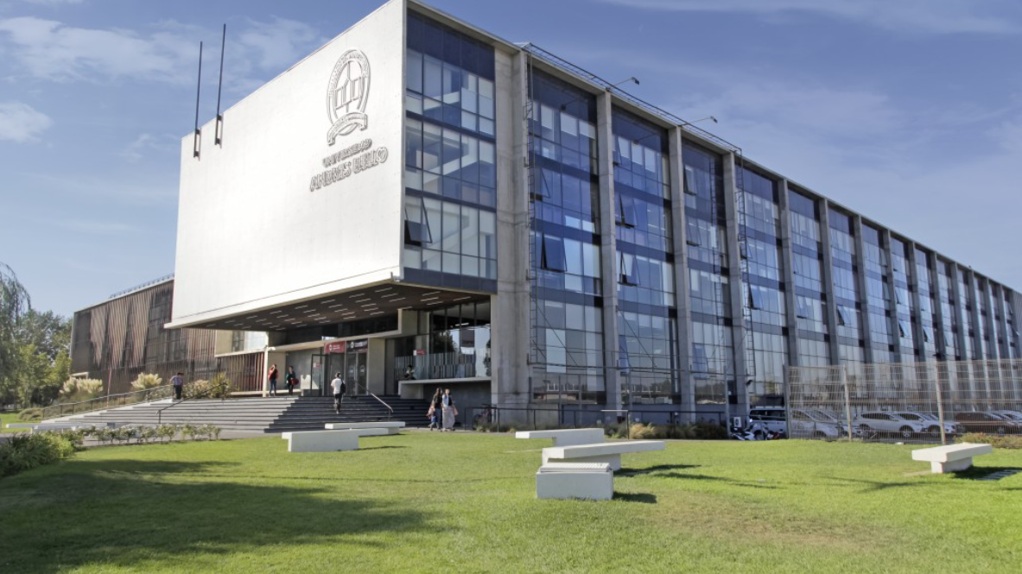
UNIVERSIDAD ANDRÉS BELLO
2023

Slide 2
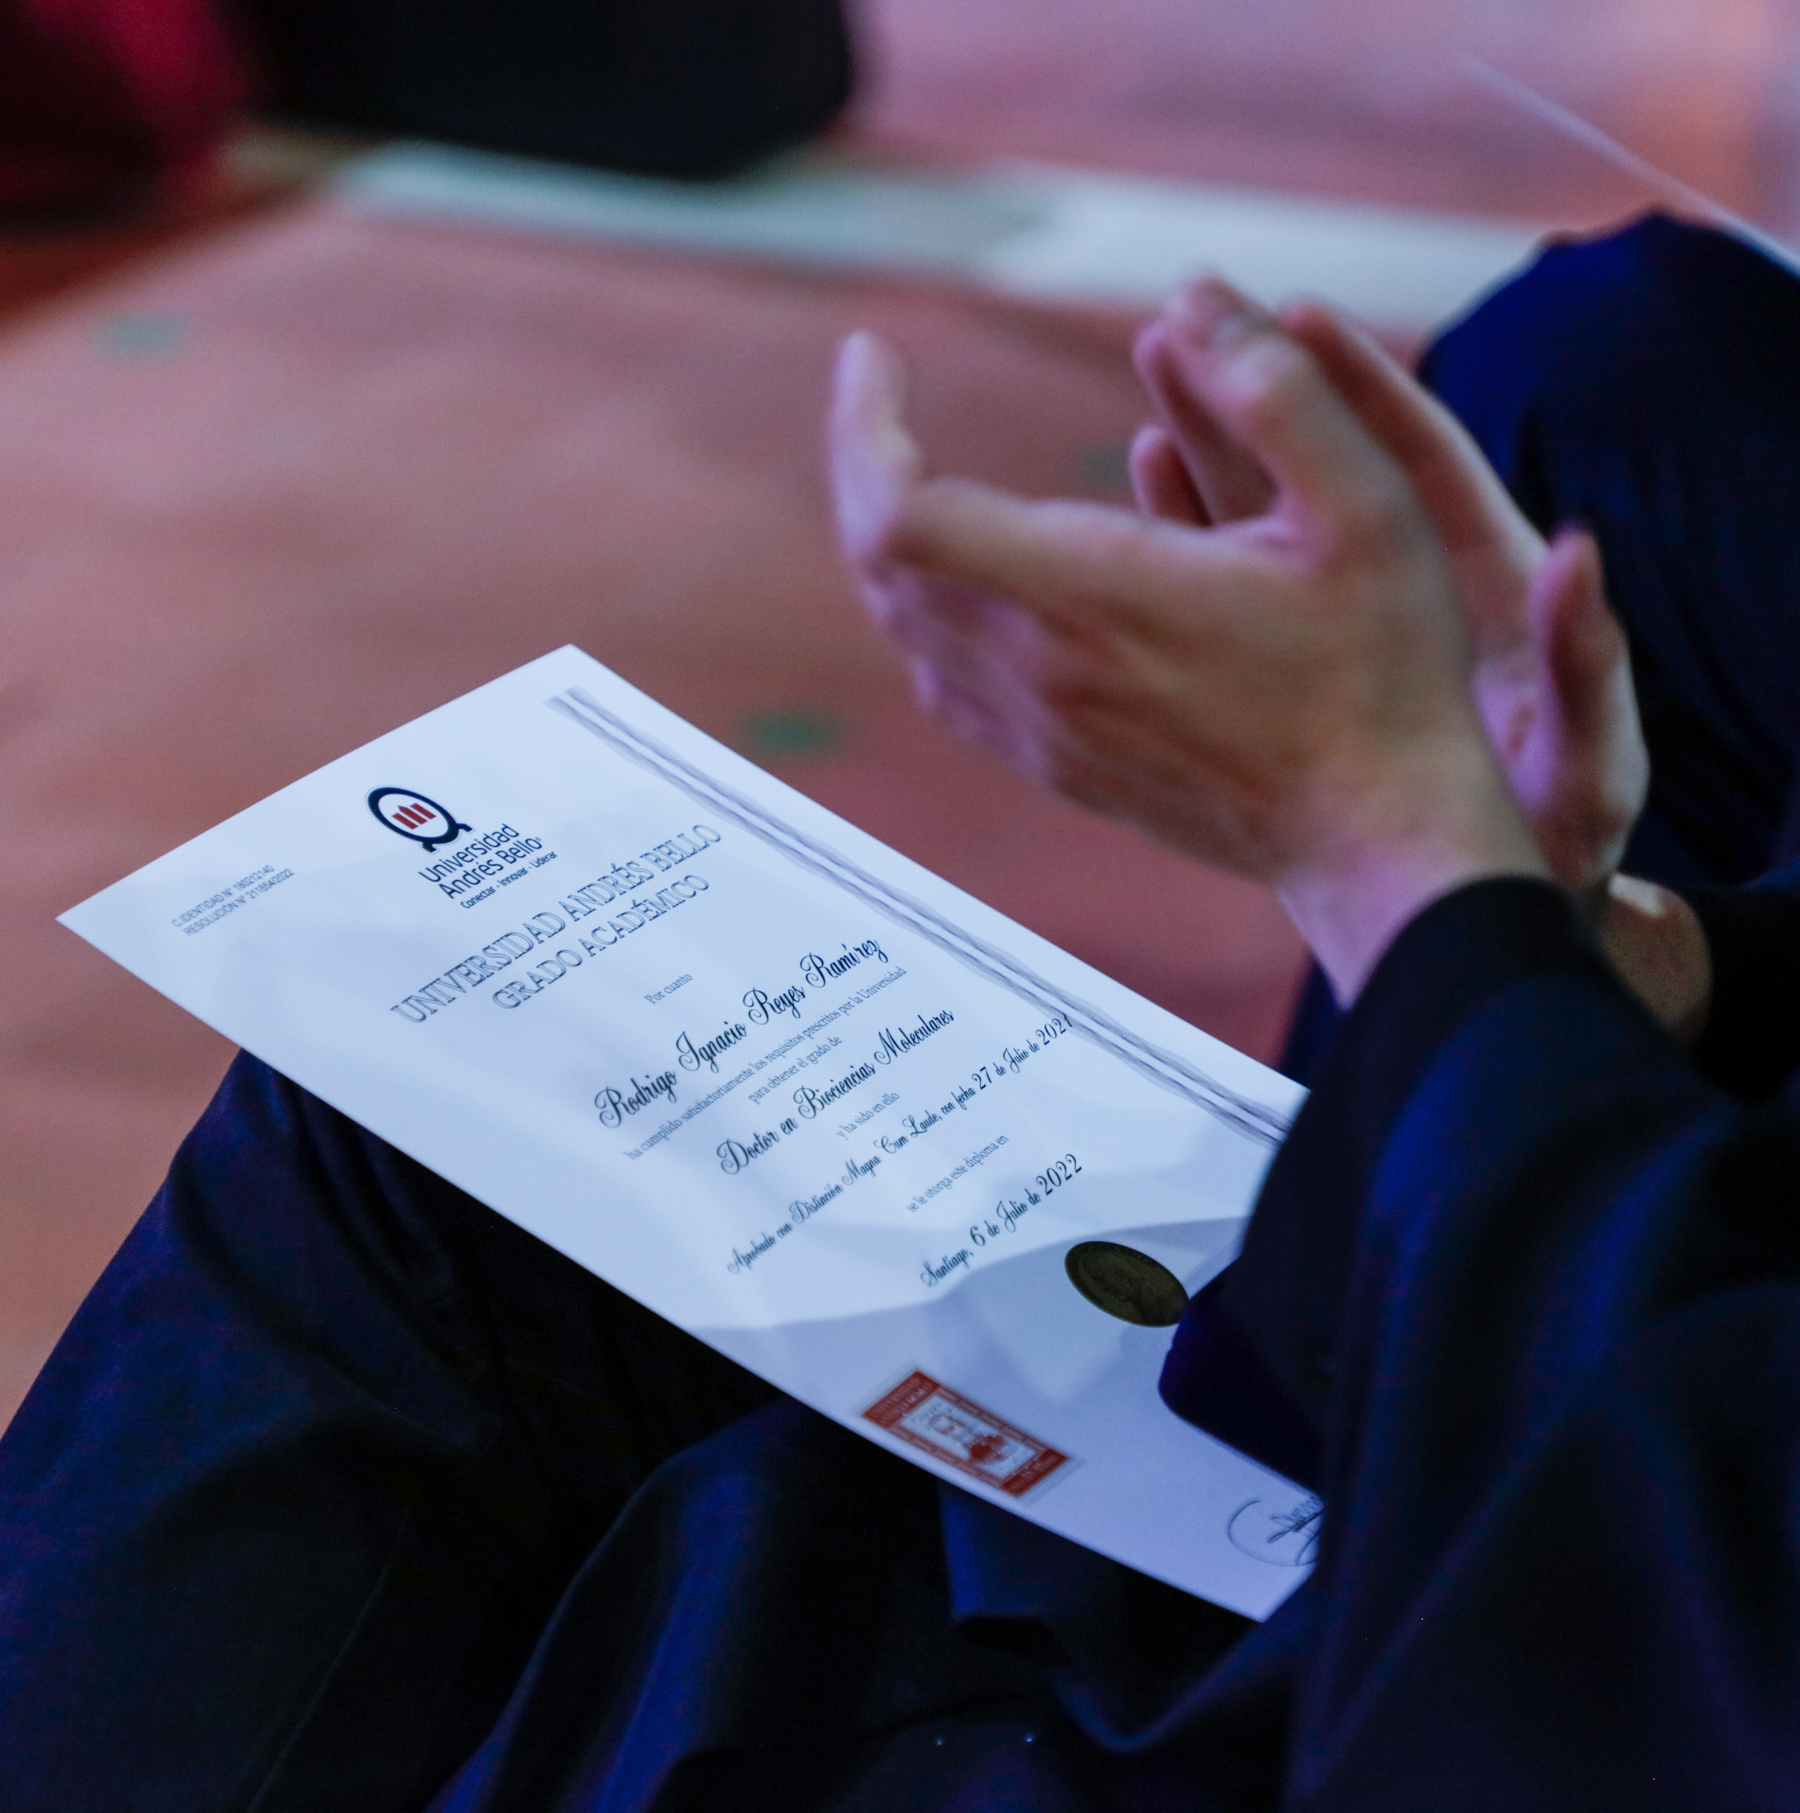
ABOUT US
UNIVERSIDAD ANDRÉS BELLO
It is a private university founded in Santiago in 1988.
Its name is inspired by Andrés Bello, humanist, politician and jurist. One of the most influential intellectuals of the nineteenth century.
He was professor at National Institute and Rector of University of Chile. In addition to its contribution to education and culture, he played a prominent role in Chilean institutionally.

Slide 3
ABOUT US
Our Mission
Our Institutional Vision
Our Values
We wish to offer an enriching educational experience tailored for a globalized world. Supported by critical thinking and the continuous generation of knowledge through research.
.
We wish to be recognized as one of the best universities in Chile.
We thrive through the sharing of knowledge. We strongly believe that global alliances will strengthen the depth and reach of our research and our opportunities to teach.
The pursuit of the common good through the advancement of knowledge, the care for our community, the care for the environment and the cultivation of long-term relationships based on a thirst for learning.

Slide 4
ABOUT US
We strive to provide a quality education for our students at both the undergraduate and graduate level. We award Bachelor, Master’s, Doctorate, and professional degrees, including certifications and diplomas.
We wish to give our students an educational experience that helps them prepare for a future where innovation, entrepreneurship, cultural diversity, critical thinking, and flexibility are necessary tools to thrive in a global world.
We want to be part of the advancement of both applied and theorical knowledge, through research in both academic and professional areas.
We want to be of service to our communities through our research, therefore, it is of the outmost importance that the scientific rigor is followed.
We believe that our work must have a positive impact in the communities that surround us.
We believe collaborative work is paramount to learning, research and development.
We believe that international standards and metrics are a way to maintain our effectiveness and efficiency.

Slide 5
ABOUT US
OUR GUDING PRINCIPLES:
Drive towards excellence. We have a passion for doing things well, with a strong spirit of self-criticism, looking for continuous improvement.
Accountability.
We believe in being responsible for our own actions, understanding that the benefits of a good education should have an impact on society.
Student Centered.
Students are at the center of all our endeavors.
Honor.
We value honesty and trustworthiness. We expect an ethical behavior of all our members, as reflected on our honor code.
Diversity and Inclusion.
We welcome all. We are respectful and tolerant of all ideas and creeds.

Slide 6
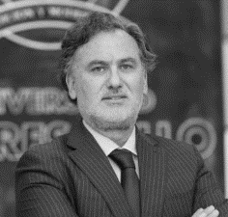
UNAB LEADERSHIP
BOARD OF DIRECTORS
Board of Directors
Officers and Deans
Juan Antonio Guzmán
Jorge Selume
Manuel Krauskopf
Julio Castro
President
Gonzalo Guzmán
Provost
Pedro Covarrubias
General Counsel
Nicolás Bronfman
Vice Provost
Carolina Torrealba
Dean of Research
Carmen Gloria Jiménez
Dean of quality assurance
Chairman
Vicechairman
Patricia Arancibia
José Pedro Undurraga
Jorge Selume A.
Raúl Peralta
Chief Financial Officer
Emilio Escobar
Dean of Continuing Education
Ana María Pavez
Vice President for Campus Services
Paola Jarur
Vice President for Public
Affairs and Communications
Carlos González
Vice president for Concepción Campus
Gerald Pugh
Vice president for Viña del Mar Campus
Luz Granier
Alejandro Álvarez
Ricardo Berckemeyer
Christian Campos
Dean of School of
Rehabilitation Sciences
Alfredo Molina
Dean of School of Life and
Biomedical Sciences
Carlos del Río
Dean of Law School
Mónica Canales
Dean of Nursing School
María Gabriela Huidobro
Dean of School Social
Sciences and Education
Pierre Paul Romagnoli
Dean of School of Sciences
Bruno Philippi
Miguel Vargas
Dean of School of Economics and Business
Ricardo Abuauad
Dean of School of Creative Arts
Alejandro Caroca
Dean of Engineering School
Patricio Burdiles
Dean of Medical School
Joyce Huberman
Dean of School of Dental Medicine

Slide 7
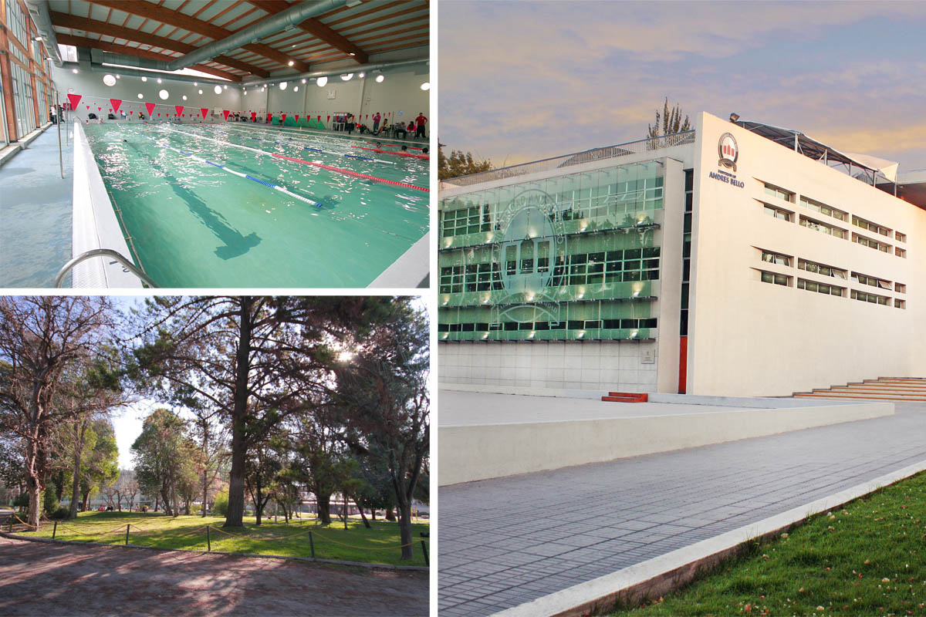
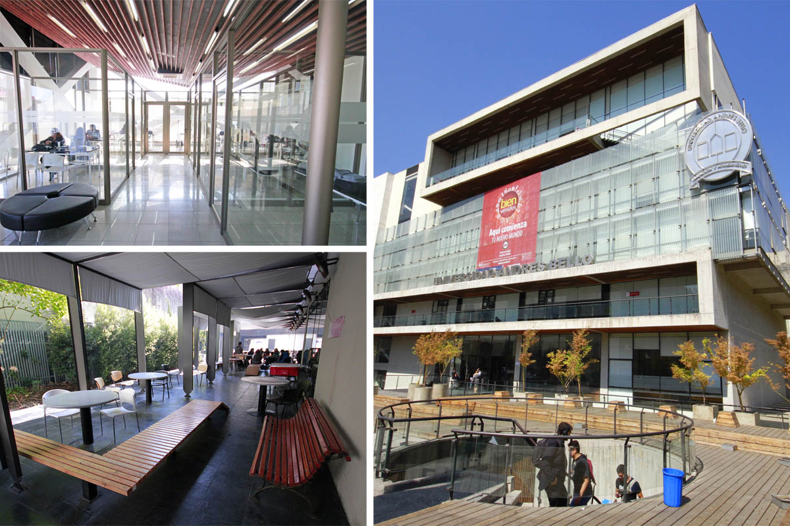
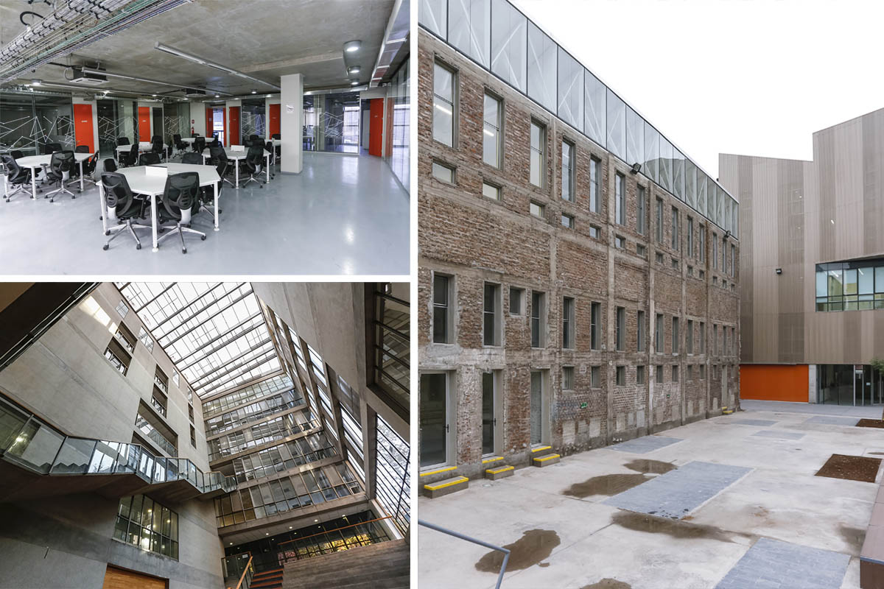
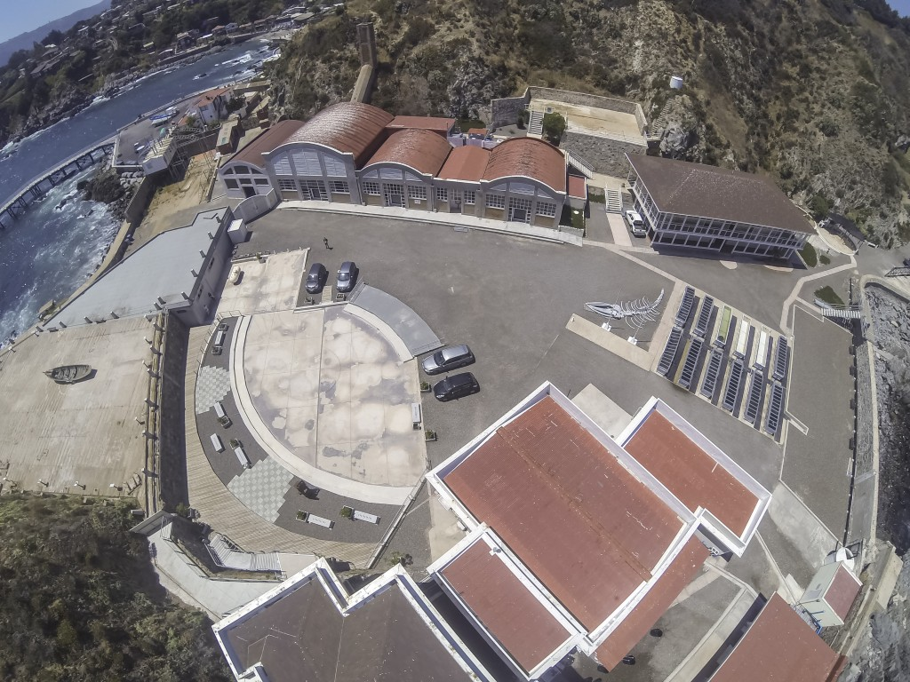
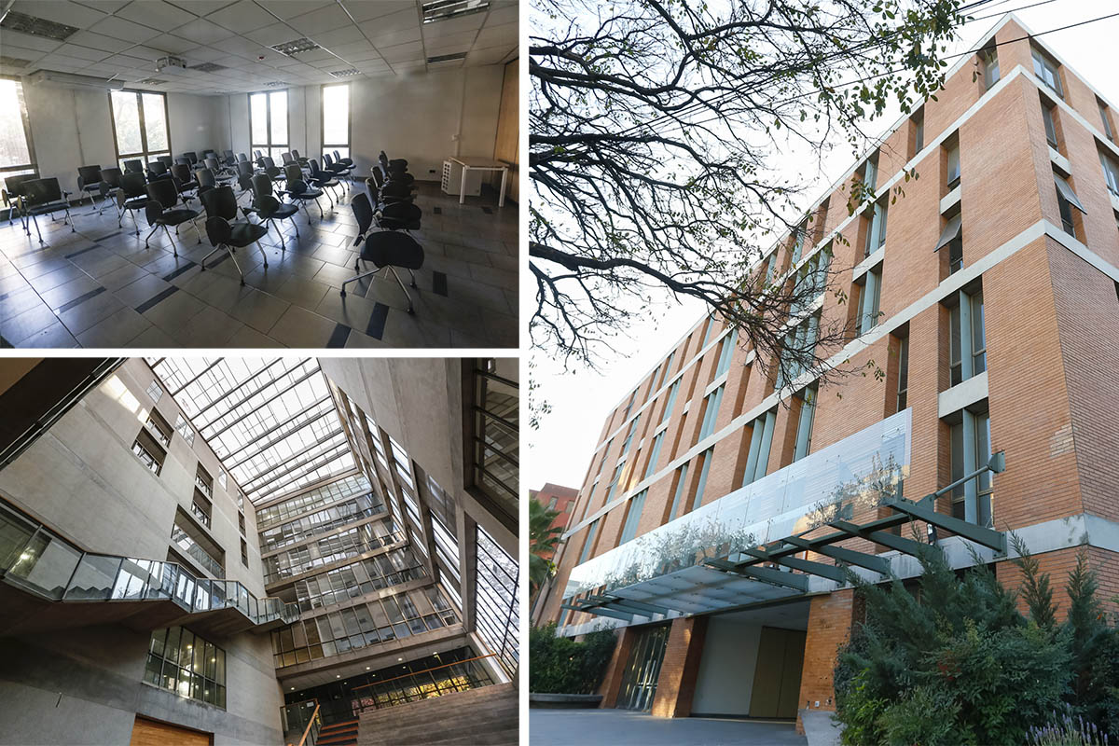
UNAB HAS 9 CAMPUS IN
THE 3 BIGGEST CITIES
CAMPUS REPÚBLICA
CAMPUS CASONA
SEDE VIÑA DEL MAR
CAMPUS BELLAVISTA
CAMPUS CREATIVO
CAMPUS QUINTAY
CAMPUS LOS LEONES
CAMPUS ANTONIO VARAS
SEDE CONCEPCIÓN

Slide 8
QUALITY ASSURANCE
ACCREDITED IN ALL AREAS
LEVEL OF EXCELLENCE
DECEMBER 2022 - DECEMBER 2028
YEARS

Slide 9
QUALITY ASSURANCE
One of 14 Chilean universities rated at the level of excellence by the National Accreditation Commission. One of only 4 private universities on the list.
8 years International Accreditation by Middle States Commission on Higher Education
2020 -2028
First Chilean Private University to become accredited in Research.
UNAB quality assurance system design Accredited by The National Agency for Quality Assessment and Accreditation of Spain (ANECA).
Implementation of the Internal Quality Assurance System for the Schools of Dentistry, Nursing, Law, and Rehabilitation accredited by ANECA.
One of only 3 Chilean universities that conduct research in all areas of knowledge (Scimago definition, 19 areas).

Slide 10
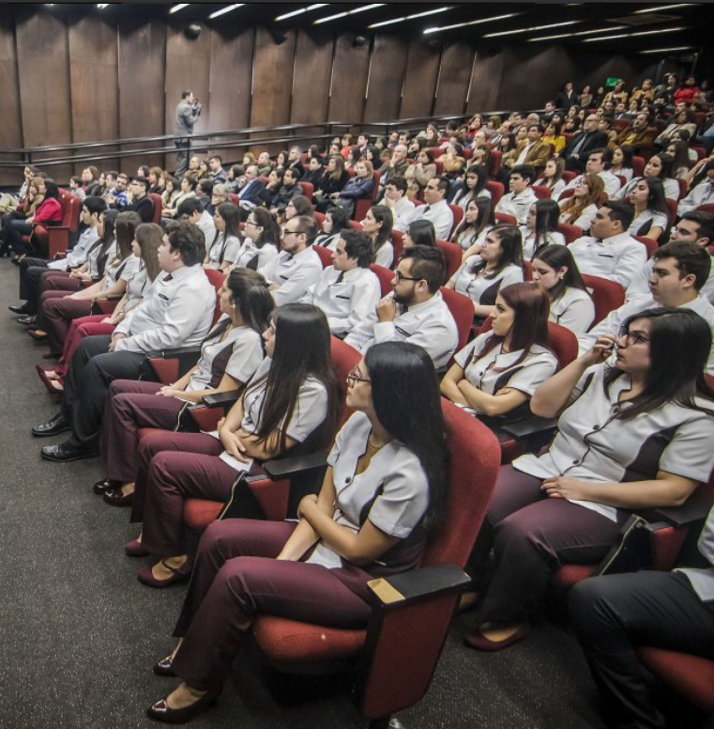
OUR STUDENTS
+ 57.000
UNAB students
50.242
7.323
245
Undergraduate students
Master students
PhD students
Concepción
12%
STUDENTS
BY
CAMPUS
Viña del Mar
20%
Santiago
68%

Slide 11
OUR STUDENTS
New students according to school:
43.000+
students currently awarded
with UNAB scholarships
22,6%
Private school
57,4%
58,6%
Semi - Private school
of the undergraduate students are the first generation to attend college
18,8%
Public school
WITH OVER 96.000
applications in 2023, Universidad Andrés Bello stands out among the institutions most Chilean students prefer.

Slide 12
OUR GRADUATES
83.000+
Alumni
30.000+
graduate alumni
89%
average employability for undergraduate alumni
2021

Slide 13
PROGRAMS AND FACULTY
OUR ACADEMIC DEGREES
62
Undergraduate
programs
33
Masters
16
Medical and dental
specialties
14
PhD
programs
OUR FACULTY
5.019
academics
80%
FDE with Graduate
degrees

Slide 14
POSITIONS
INTERNATIONAL RANKINGS
One of the 4 Chilean universities recognized by Shanghai Ranking
4th
Place
In
Chile
1st in Chile
ACADEMIC RANKING OF WORLD UNIVERSITIES (ARWU) 2022
TIMES HIGHER
EDUCATION
IMPACT RANKING 2022
UNIVERSITY RANKING BY ACADEMIC PERFORMANCE (URAP) 2022
One of the most prestigious research rankings in the world
Based on the fulfillment of the Sustainable Development Goals through research, engagement with the environment and institutional
management.
This ranking measures the research performance of three thousand institutions worldwide, including 29 Chilean universities.
QS Stars University Ratings
UNAB scored 5 stars in the following categories: Online learning, Inclusiveness, Employability, and Social Responsibility.
WITHIN THE BEST 3 IN CHILE AND 11 IN LATAM:
4 stars in Teaching and Internationalization
NATURE INDEX RANKING 2022

Slide 15
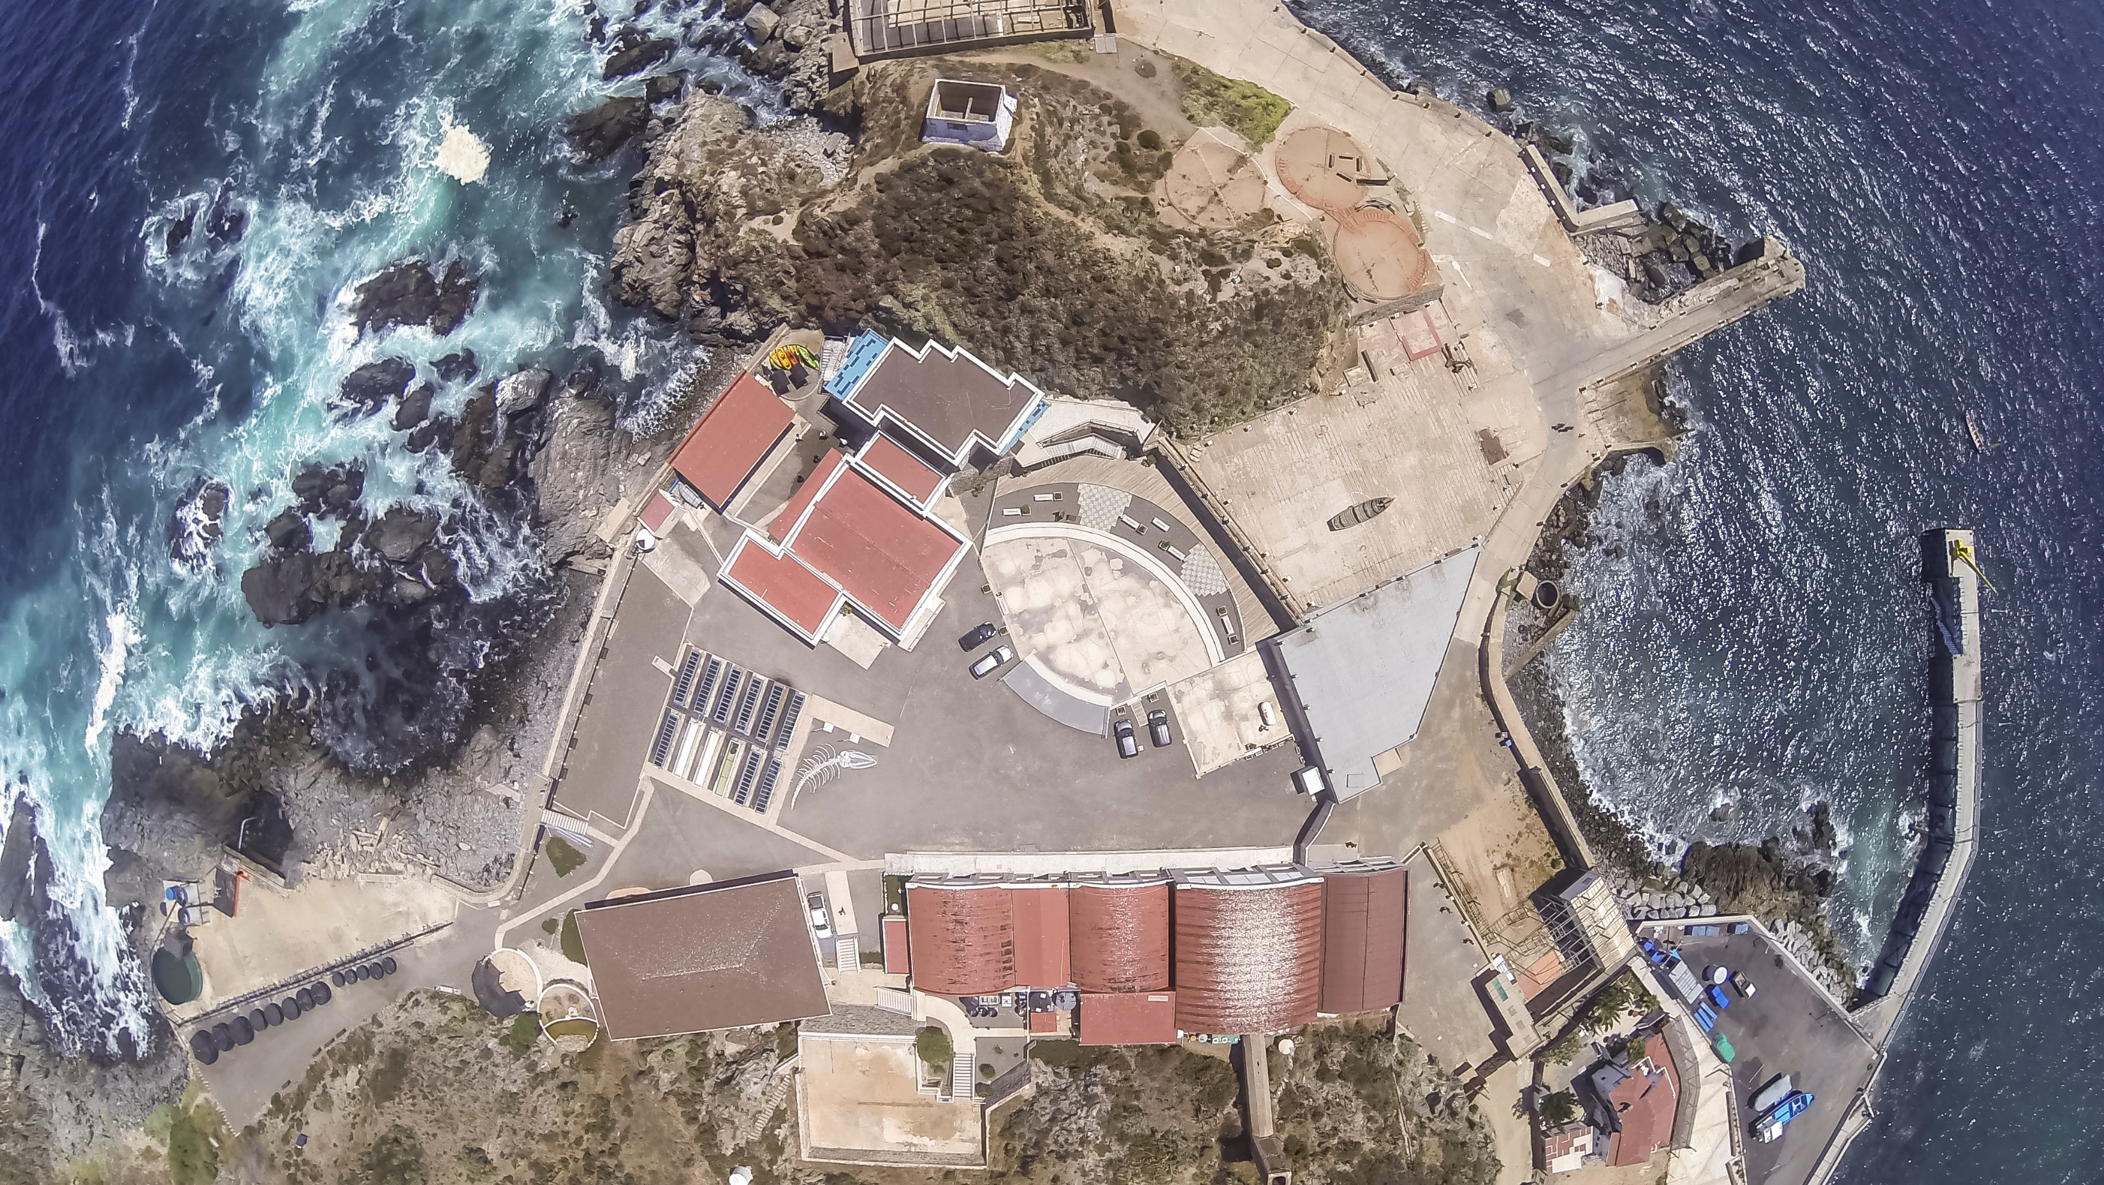
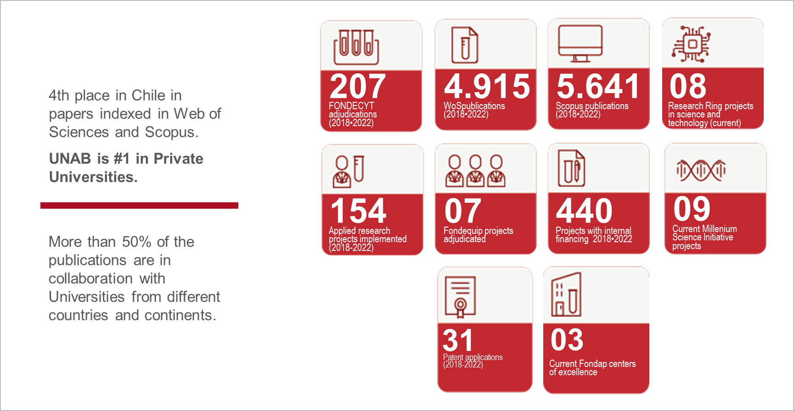
RESEARCH AND INNOVATION AS A KEY INSTITUTIONAL PILLAR

Slide 16
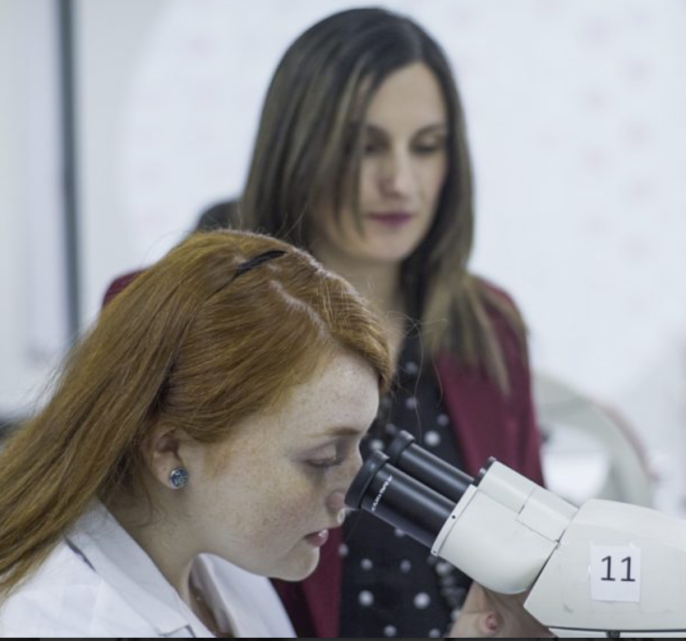
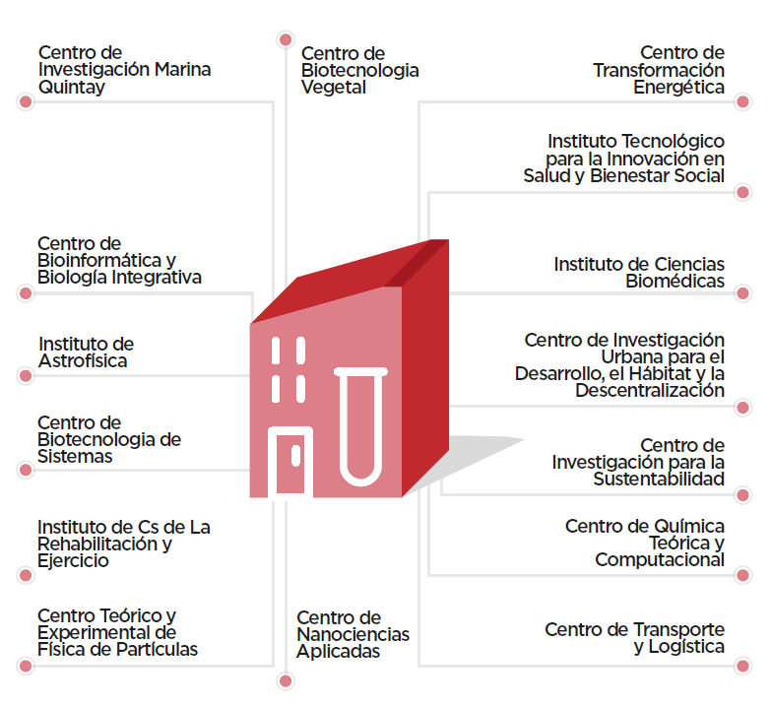
DISCIPLINARY RESEARCH AND PUBLIC POLICY RESEARCH CENTERS AT THE HIGHEST LEVEL
Quintay Marine Research Center
Vegetable Biotechnology Center
Energy Transformation Center
Theoretical and Experimental Center for Particle Physics
Public Health Institute
Technological Institute for Innovation in Health and Social Well-being
Astrophysics Institute
Institute of Biomedical Sciences
Center for Systems Biotechnology
Public Economic Institute
Center for Bioinformatics and Integrative Biology
Research Center for Sustainability
Rehabilitation and Exercise Science Institute
Sports and Wellness Institute
Center for Theoretical and Computational Chemistry
Public Policy Institute
Center for Applied Nanoscience
Transportation and Logistics Center
Urban Research Center for Development, Habitat, and Decentralization

Slide 17
TECHNOLOGY IN THE SERVICE OF EDUCATION 2022
+ 6.800 students learning in Simulated Hospitals with state-of-the-art immersive technology
+ 3.190 students learning Physics with advanced PHET simulations.
17.000
students with digital education experiences.
UNAB and Microsoft:
1st Deep partnership of the Chilean university system. .
+ 2.000 students with certificates. Microsoft and IBM (Data Science and Artificial Intelligence)
+400 students at the School of Education learning how to teach through the Metaverse
+ 800 Obstetrics, Nutrition, and Kinesiology students are tele-treating patients with a state-of-the-art platform.
2.235 students learning chemistry and biology with Labster simulators.

Slide 18
CONTRIBUTION TO THE COMMUNITY
DENTAL
PRACTICE
+40.000 Services
+1.000 Participants in oral health promotion activities
LAW CLINIC
+1.600 Legal Advisories / Orientations
+1.400 Cases processed
VETERINARY
CLINIC
+15.000 Clinical services
+2.700 Surgical services
PSYCHOLOGICAL CLINIC (CAPSI)
+14.000 Services
+2.000 Beneficiaries
TAX
CLINIC
+1.500 People advised
UFAS WILDLIFE PROGRAM
+900 Clinical examinations
+500 Services rendered

Slide 19
CULTURAL PROMOTION
Attendees in cultural activities from 215 national locations and 30 countries.
16 alliances with embassies and other cultural entities
+ 260 cultural activities in the last 4 years.
+ 330.000 attendees (2019-2022)
15 mil students attended cultural activities in 2022.

Slide 20
OUR COMMITMENT TO SUSTAINABLE DEVELOPMENT
UNAB consolidated the alliance with Global Compact (United Nations) as the host in Chile

Slide 21
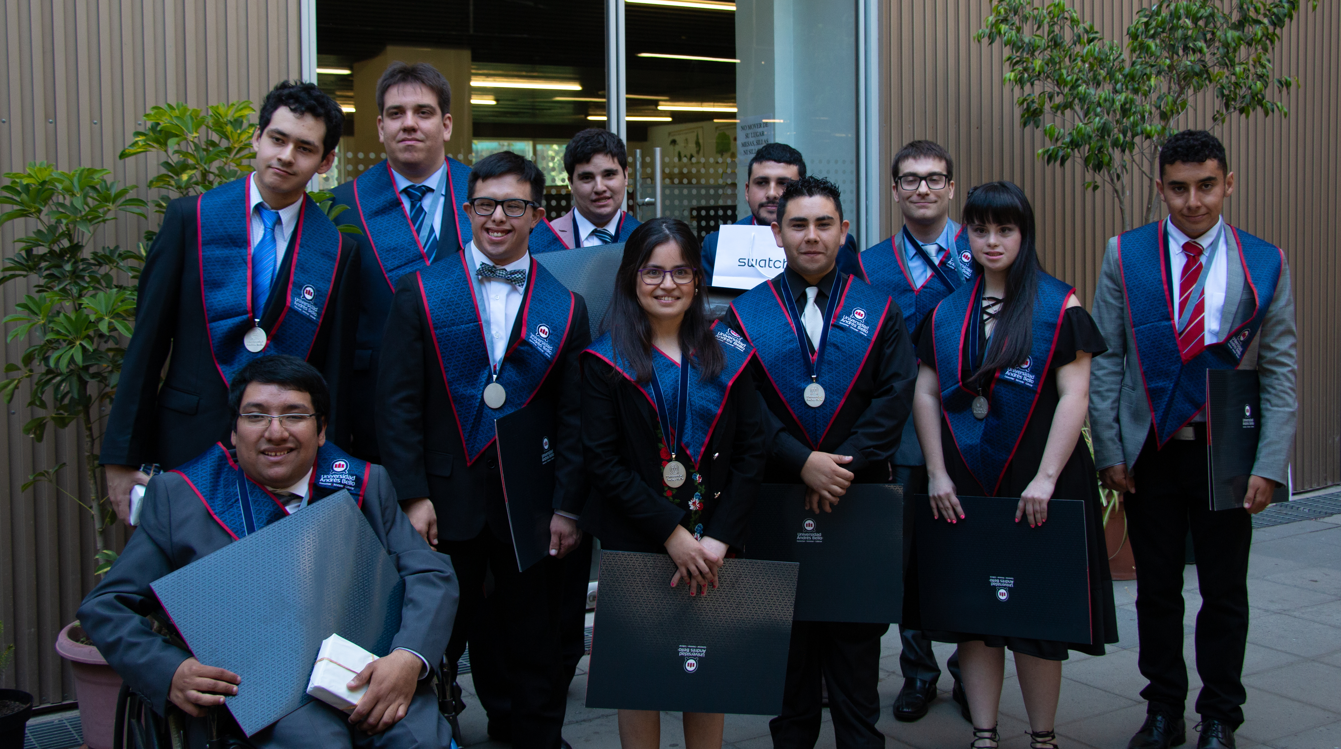
INCLUSION AS A MISSIONAL SEAL
JOB SKILLS DIPLOMA
An innovative program that trains young people with special educational needs for their insertion into the world of work.
+ 120 students on three campuses
490 program graduates
INCLUSION OBSERVATORY
Its mission is to promote a culture that values diversity and thus favors the quality of life and participation in the equity of people at risk of social exclusion through actions associated with specialized training and contribution to the debate and generation of inclusive public policies.

Slide 22
SPORTS
301
N°1
The only
1.304
51
sports scholarships
The university that contributes the most athletes to national and international high-performance competitions.
university with a sports institute dedicated to promoting healthy lifestyles and contributing to public sports policies
students belonging to UNAB teams
sports teams

Slide 23
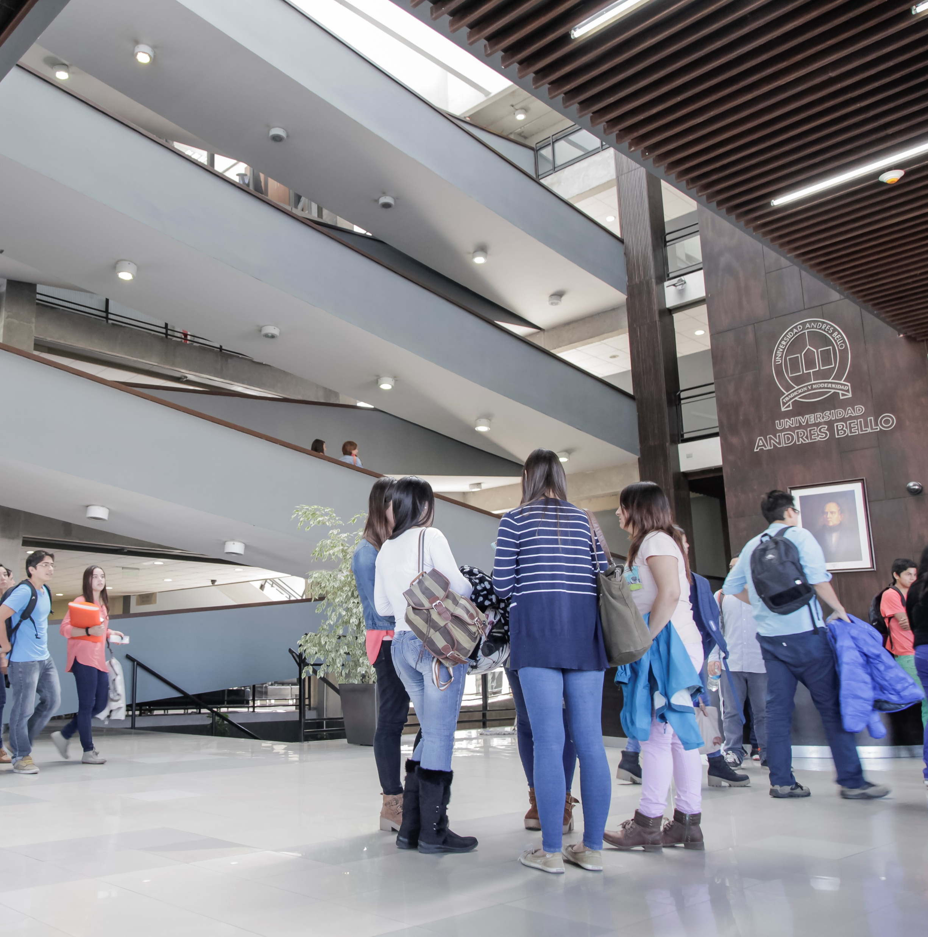
COMMITMENT AND OUTREACH
Andrés Bello University Endowment
An endowment reserve fund was created in 2022 with an initial CLP $30 billion capital.
The proceeds from investments in this fund will be used for student scholarships, entrepreneurship, and applied research projects of the UNAB community.
The first group of scholarships was awarded in December and benefited over 100 students from the three campuses.

Slide 24
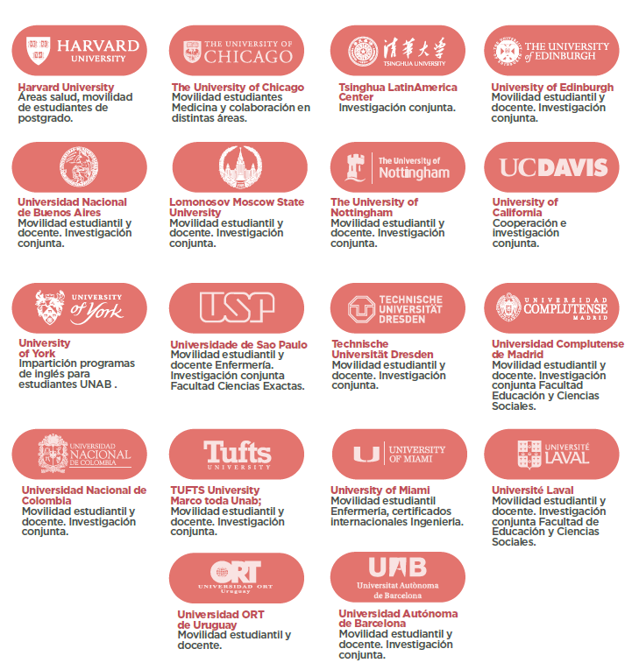
INTERNATIONALITY AS PART OF UNAB ACADEMIC MODEL
Over 340 agreements with leading universities world-wide

Slide 25
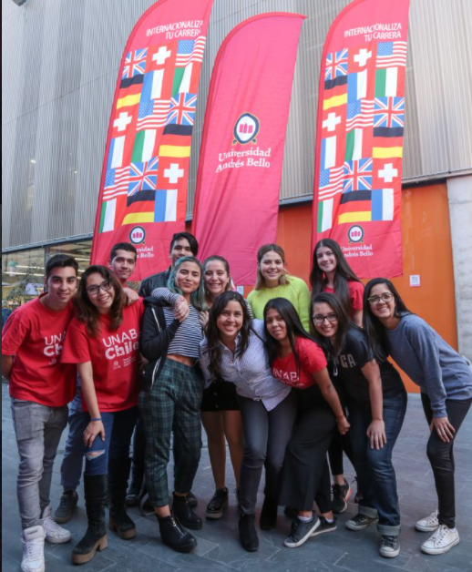
INTERNATIONALITY AS PART OF UNAB ACADEMIC MODEL
OVER
10.000
OVER
+ de 1.000
students with international exchange
UNAB students participated in activities with foreign universities in 2022, such as exchanges, short courses, and dual degrees (virtual and on-site).
OVER 2.000
1.700
international students participated in activities at UNAB in 2022 (virtual and on-site)
students enrolled in 2022 in internationally certified subjects
*2022

Slide 26
UNIVERSIDAD ANDRÉS BELLO
2023

